Slide 1
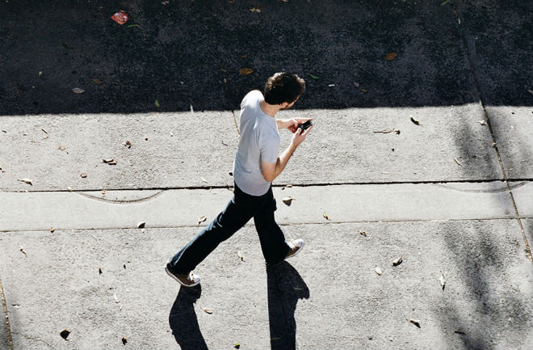

CrashAlert
Enhancing Peripheral Alertness for Eyes-Busy Interaction while Walking
Human-Computer Interaction Lab
Juan David Hincapié-Ramos
jdhr@cs.umanitoba.ca
Pourang Irani
irani@cs.umanitoba.ca
May 2, 2013 – CHI '13
Paris, France
Notes:
Hello Everyone,
My name is Juan David Hincapie-Ramos, and this is work I did together with Pourang Irani at the University of Manitoba.

Slide 2
Eyes-busy interaction while walking
1
Notes:
This is a common image: people use their cellphones while walking.
And what we know about this is that when they do it together, people are not very good at either walking or interacting.

Slide 3
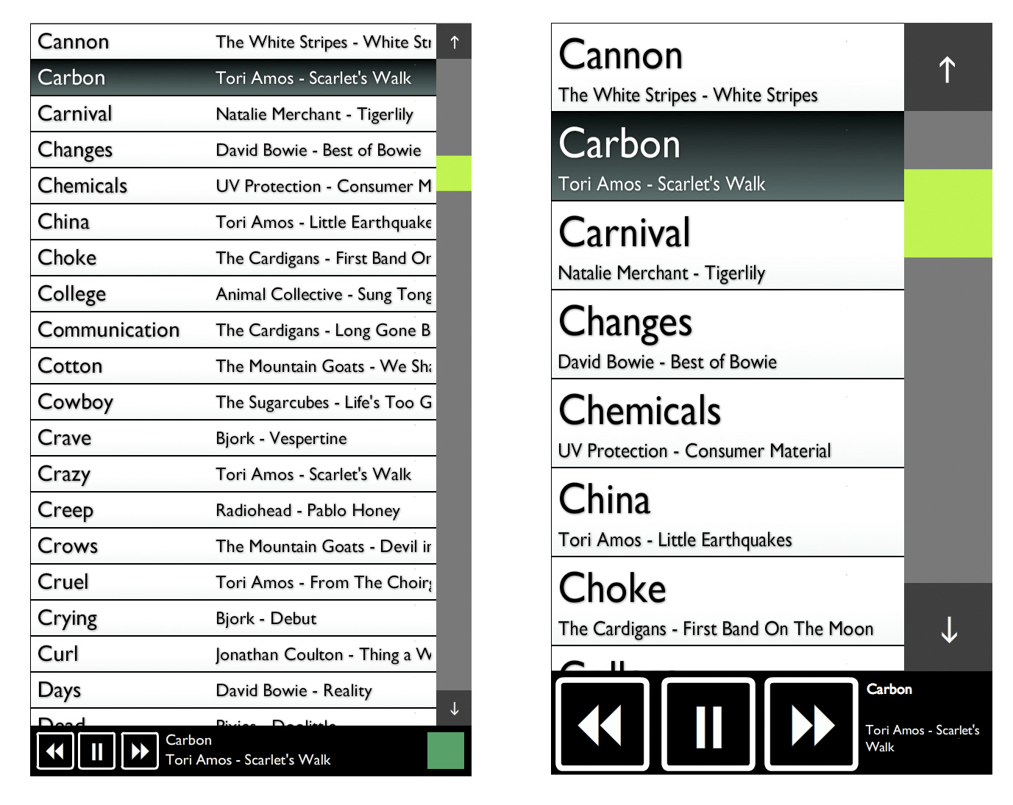
Kane et al. – MobileHCI’08
2
Notes:
One traditional approach has been to optimize interfaces into what is called walking user interfaces.
Walking user interfaces aim at making it easier for the user to interact with their mobile devices while on the go. For example by providing audio feedback, or better buttons.
For example, Kant et al proposed this music player which buttons would grow bigger once the user starts moving.

Slide 4
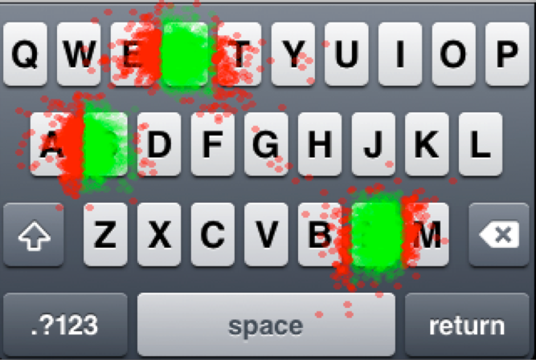
Goel et al. – CHI’12
3
Notes:
Another example is Goel et al.s adaptive correction of text input.

Slide 5
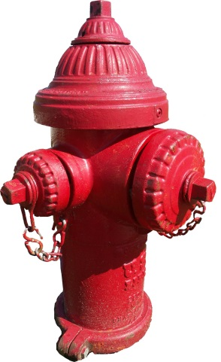
CrashAlert
4
Notes:
While better interfaces for walking is a good exploration are,
there is another important problem and it is related to the safety of interacting with the cellphone while walking:
people are crashing into elements of their environment.
This includes other people, but also objects which can cause more serious damage like lamp posts, trees, manholes, and hydrants.
Let’s do a quick survey: how many of you have crashed into something while walking and using your cellphones?
How many of you have been crashed by someone else?

Slide 6
Person’s field of view does not cover the area in the direction of the movement
6
5
Notes:
OK, people crash into such objects because they lay out of their field of view. Not only their field of view point downwards, but it’s also narrower as they are focused on their mobile phones.
Only in 2008 there was a twofold increase in texting related accidents, something which has prompted discussions in terms of policy making [like forbidding to do it in public] and mobile phone usage etiquette.

Slide 7
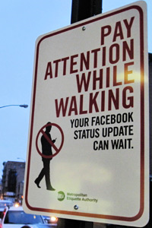
Jay Shells’ Metropolitan Etiquette Authority
6
Notes:
For example, there have been some public awareness campaigns trying to convey the message that we have to do something about it, and it’s mainy that we have to stop doing it.
Jay Shells’ Metropolitan Etiquette Authority

Slide 8

Padded Lampposts at London’s Brick Lane by 118 118 (www.118.com)
7

Slide 9
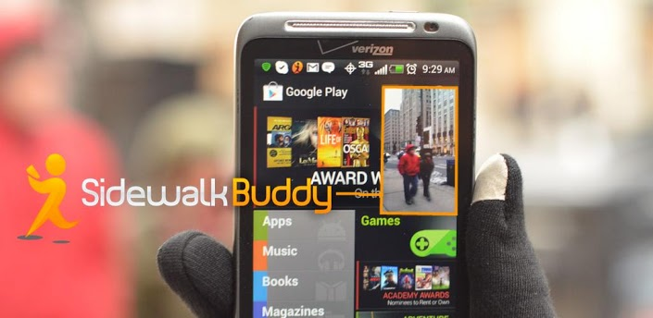
Sidewalk Buddy – Android
8
Notes:
There are also some apps like the sidewalk buddy

Slide 10
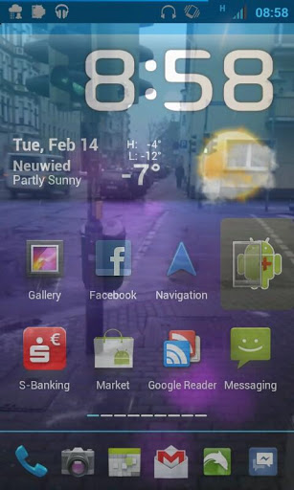
Transparent Screen for Android – Sascha Affolter
9
Notes:
Or the Transparent Screen and others like “Walk and Text”, Walkie, “Type’n Walk”

Slide 11
Horizontal Device
Attention on the Display
6
10
Notes:
However, this solutions are not really appropriate because people hold their devices horizontally,
and, as I said before, what they are really focused on is their device display.

Slide 12
Direction of the Movement
11
Notes:
OK, not surprisingly people crash into such objects because they lay out of their field of view.

Slide 13
Initial User Study
6
12
Notes:
In order to better inform how a potential solution would work, we did an initial user study at the campus cafeteria: an area that’s pretty congested and where people often use their mobile devices while walking.

Slide 14
Dodge & Slow Down
Heads Up
Nearly
Crash
Full Stop
Least Severe
Most Severe
Encourage More Dodging
Alert on Imminent Collisions
Initial User Study
13
Notes:
What we observed is that people handle potential solutions at varying degrees of cost.
Simpler solutions or the least severe corrections include simple dodging of the obstacle from afar.
All the way to a “bump” or a “near crash”
The important thing here is that such correction strategies can be done consecutively: first dodge, reevaluate, then lift your head, reevaluate, then make a full stop… and so on.
And so we derive two basic design requirements for any solution:
first, that it should encourage more of the simpler solutions early on
second, that it should alert on imminent collisions.

Slide 15
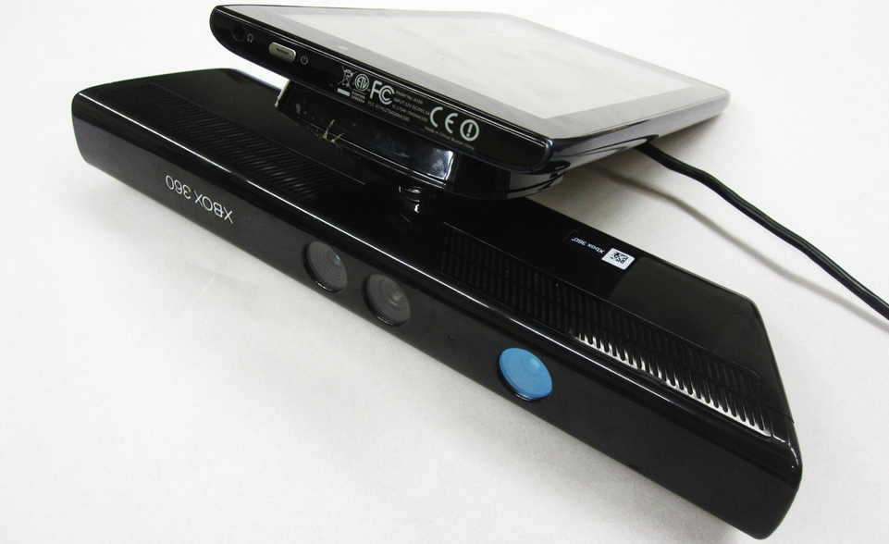
CrashAlert – Basic Set-up
14
Notes:
In order to implement the requirements we propose a simple enhancement to a mobile device, which is a depth camera pointing in the direction the user is walking.

Slide 16
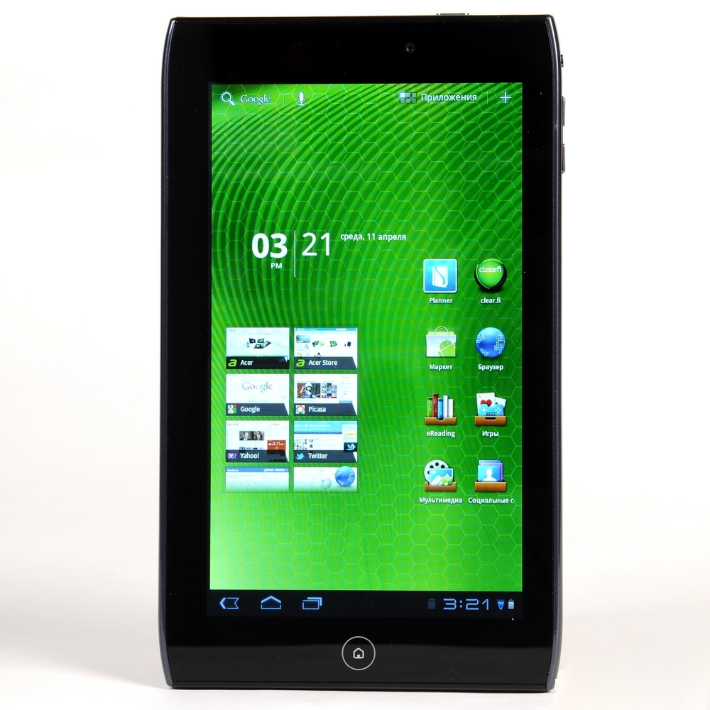
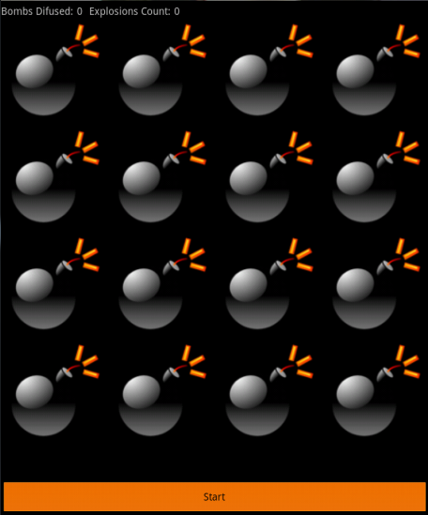
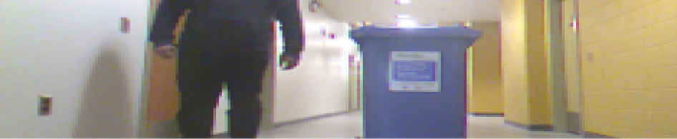
CrashAlert – UI
15

Slide 17
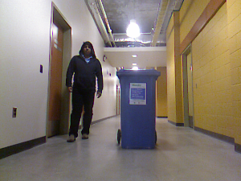

CrashAlert – UI
16

Slide 18
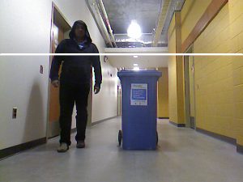

CrashAlert – UI
16

Slide 19
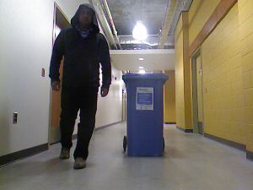

CrashAlert – UI
16

Slide 20
Video 1
Video 2
Live Demo
17
Notes:
Demo

Slide 21
User Study
18

Slide 22
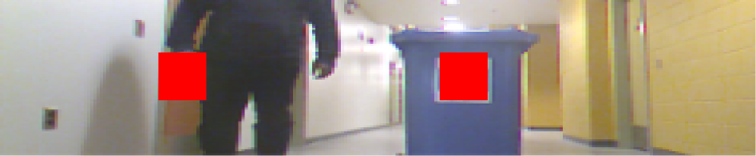


Color
Depth Columns
Depth Mask
UI Design
19

Slide 23
Color
Depth Columns
Depth Mask
UI Design
19

Slide 24
Color
Depth Columns
Depth Mask
UI Design
19

Slide 25
Color
Depth Columns
Depth Mask
UI Design
19

Slide 26
4×8×2 Experimental Design
Walking Time
Performance
Collision Reaction
Perceived & Interview
Experimental Design
20
Notes:
Walked in a cafeteria environment during the lunch hours.
Walking distance was 180 meters.
They played a wak-a-mole game.
We used actors to guarantee at least four collisions, although they faced many more as we’ll see.
The research team observed the participant and annotated how they handled each potential collision.

Slide 27
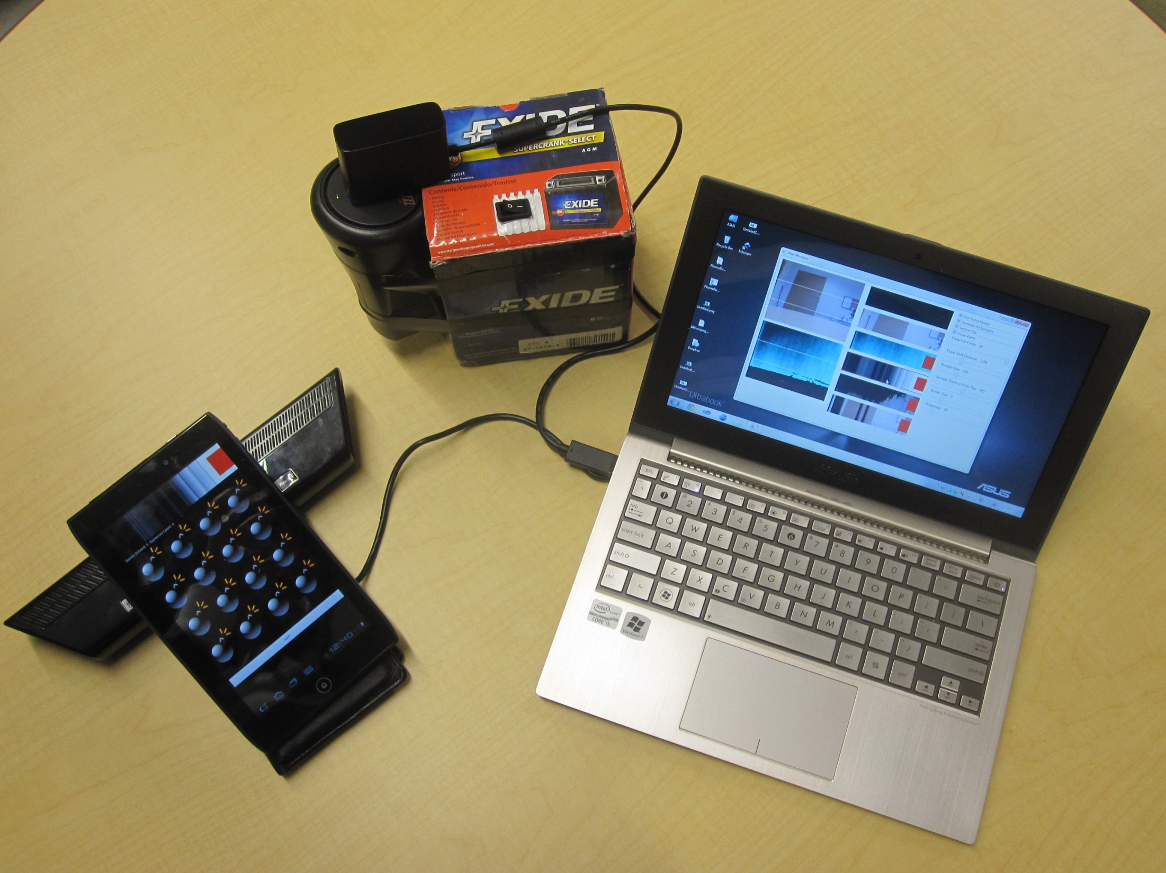
Hardware Setup
21

Slide 28
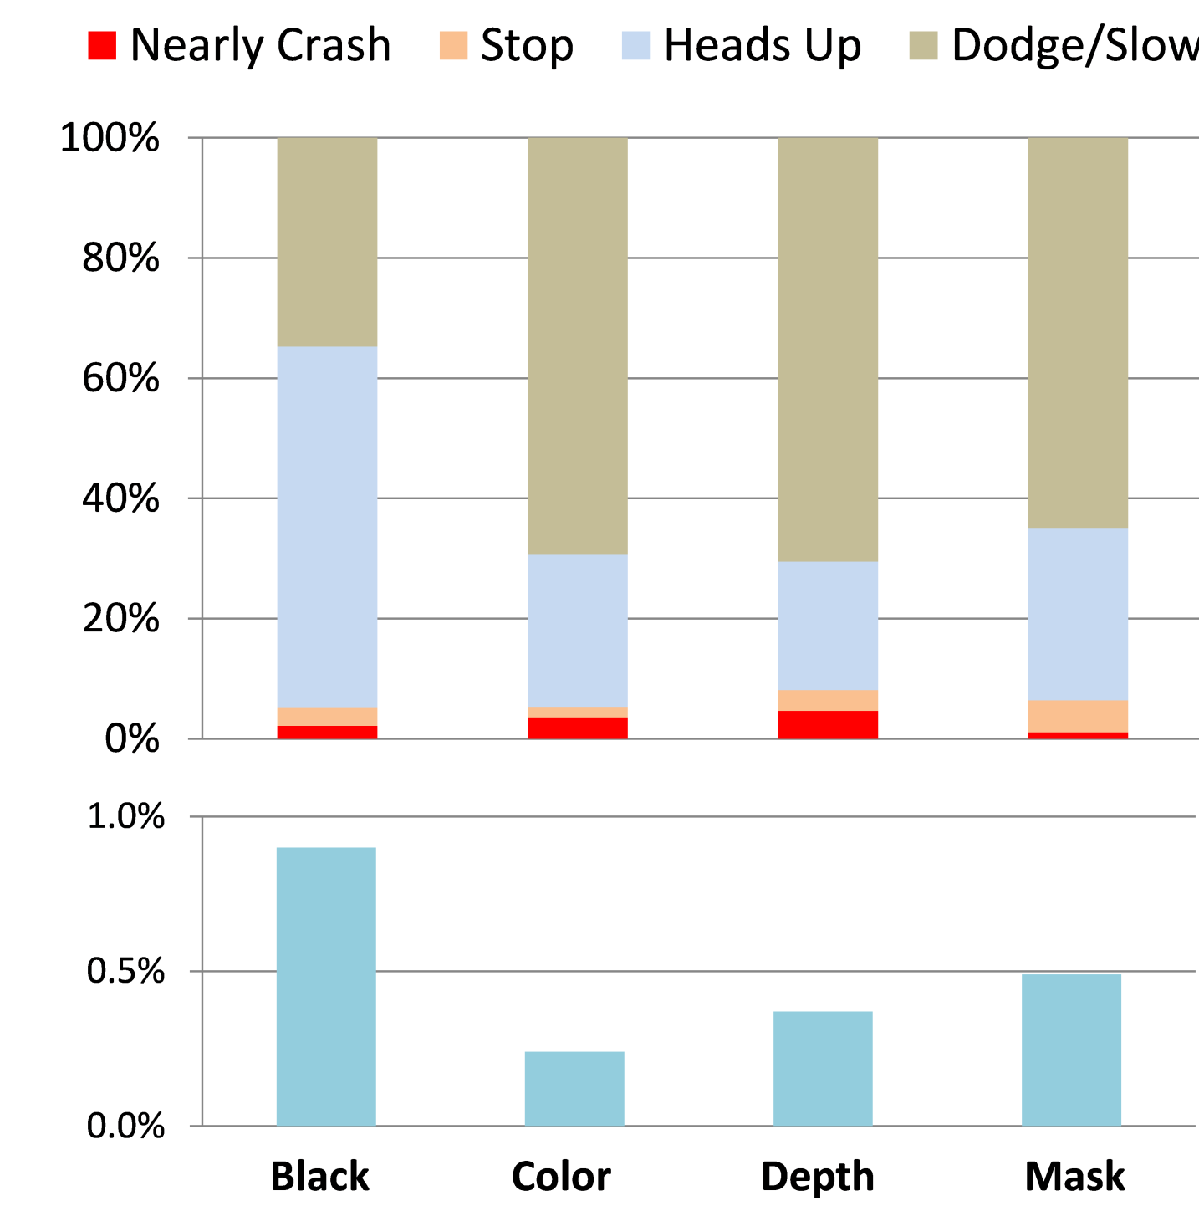
Quantitative Results
22
Notes:
Our study revealed that users indeed had a safer handling of potential collisions.
They had a double percentage of dodge/slow/downs when using crash alert.
This is an important result because as we noted this allows them more serious reactions as they re-evaluate the situation later on.
The little increase in “nearly crashes” at the bottom was not significant.
And this better handling came at no cost in error rate- no significant difference

Slide 29
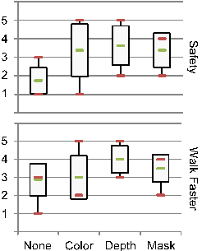
Qualitative Results
23
Notes:
Users reported that they felt safer while using any of the visualizations,
and that they felt as if they were walking faster – even if the time shows that they didn’t – when using the depth columns visualization.

Slide 30
Abstraction
P8 “I have to check the [color] image much more and longer”.
P7 “[with the depth image] I can see the [thin] veranda which I couldn’t in the color image”.
Interview Results
24
Notes:
We also obtained very valuable feedback from the post-experimental interviews.
One of the categories is the level of abstraction of the images.
In general, participants didn’t like the color images because they felt they required much more attention than they were willing to give.
For example, P8 says…
On the contrary the depth image highlighted things that were relevant and difficult to see in the color image
For example, P7 says…

Slide 31
Abstraction
Navigation
Walk toward to dark zone
Follow the alert
Interview Results
25
Notes:
Another category is how they used CrashAlert as navigational support, and this happened in two unexpected ways:
First, some users reported that they would just follow the dark [using the depth columns image]… because the dark was the area they could trust it was clear of obstacles.
Second, some users reported that they would follow the alert. They happened when they were walking behind a person they thought could be going on the same direction. So they would follow that particular alert into the crowd as they knew that person would have figured out the obstacles or already pushed people away.

Slide 32
Abstraction
Navigation
Alerts
P1 “I couldn’t tell whether people where coming toward me or moving further away”.
P3 “[I would like to see] a significant level indication of obstacles like how much danger if collision occurs”.
Interview Results
26
Notes:
Finally, users thought it would be nice to have richer alerts, or alerts that could provide them with more glanceable information.
Direction
For example, P1 said…
Level of danger -

Slide 33
Safer Collision Management
Recover Field of View
Reduced Depth Visualizations
Visual Alerts
Conclusions
27
Notes:
To conclude,

Slide 34
Thank you! Questions?
Human-Computer Interaction Lab
Juan David Hincapié-Ramos
jdhr@cs.umanitoba.ca
Pourang Irani
irani@cs.umanitoba.ca
The End
28

Slide 35
CrashAlert
#

